Slide 1


IDS 1721
Computing and Problem Solving for STEM
Chapter 04
More on arrays

Slide 2
Recall
For a given array we found the maximum value of the array.
We also reversed the array.
MATLAB has built-in functions to handle that.
You can try these following commands:
>> a = [3, 6, 1, 2, 7, 4];
>> max(a)
>> min(a)
>> flip(a)

Slide 3
Recall
MATLAB has a rich library of built-in mathematical functions that can be applied directly to arrays. Some common functions include:
Sine, Cosine, and Tangent:
>> X = [0, pi/4, pi/2, pi];
>> S = sin(X); % Sine of each element
>> C = cos(X); % Cosine of each element
>> T = tan(X); % Tangent of each element
Exponential and Logarithms:
>> A = [1, 2, 3; 4, 5, 6];
>> E = exp(A); % Exponential of each element
>> L = log(A); % Natural logarithm of each element
>> L10 = log10(A); % Logarithm base 10 of each element
Square Root and Absolute Value:
>> A = [-9, 16, 25];
>> SQ = sqrt(A); % Square root of each element
>> ABS = abs(A); % Absolute value of each element

Slide 4
Mathematical Operations on Arrays
Element-Wise Operations
Element-wise operations are applied to each corresponding element of arrays.
Element-wise addition/subtraction: These operations are performed directly without a dot.
>> A = [1, 2, 3];
>> B = [4, 5, 6];
>> C = A + B;
>> D = A - B;

Slide 5
Element-wise operation
In MATLAB, these operations are prefixed by a dot (.) when used with operators like multiplication, division, or power.
Element-wise multiplication:
>> A = [1, 2, 3];
>> B = [4, 5, 6];
>> C = A .* B;
Element-wise division:
>> A = [10, 20, 30];
>> B = [2, 4, 5];
>> C = A ./ B;
Element-wise power:
>> A = [2, 3, 4];
>> B = [1, 2, 3];
>> C = A .^ 2;
>> D = A .^ B;

Slide 6
MATLAB features
A vector is a one-dimensional array.
If x is a vector, then y = x’ has the opposite orientation, and we say that x has been transposed.
A row vector is list of values inside square brackets separated by spaces or commas, e.g., v = [19 2 -3] or v =[19, 2, -3].
A column vector is list of values inside square brackets but separated by semicolons, e.g., v = [19; 2; -3].
Longer vectors can be made by ‘gluing together’ shorter vectors:
x = [10 20]; y = [30 40 50]; z = [x y];
x = [10; 20]; y = [30; 40; 50]; z = [x; y];

Slide 7
MATLAB features
If x is a vector, then n = length(x) assigns its length to n.
To access an existing element within a vector, we can call the value by passing the position: x = [10 25 20]; y = x(2);
Use linspace() to construct row vectors with equally spaced values.
In general, x = linspace(a,b,n) is equivalent to
h = (b-a)/(n-1);
for k=1:n
x(k) = a + (k-1)*h;
end
Notes:
Note that the spacing between components is (b−a)/(n−1) and not (b−a)/n.

Slide 8
MATLAB features
The colon notation can be used to generate a row vector of equally spaced values with a prescribed spacing. For example, x = 1:.3:2 is equivalent to x = [1.0 1.3 1.6 1.9], i.e., read x = 1:.3:2 as “x goes from 1 up to 2 in steps of 0.3.” Note that the last component has the value 1.9, not 2.
logspace creates a vector with values that are equally spaced logarithmically.
Example: x = logspace(-1,-6,6) is equivalent to
x = [10ˆ-1 10ˆ-2 10ˆ-3 10ˆ-4 10ˆ-5 10ˆ-6]

Slide 9
MATLAB graphing
The plot funtion can:
  Display the data points (x_{k},y_{k}) defined by a pair of vectors that have equal length and orientation.
  The command plot(x,y) “connects the dots,” to display the graph of y versus x in a figure window.
  plot(x,y1,x,y2,x,y3,...) plots y1 versus x, y2 versus x, y3 versus x, etc.
pause stops the program and waits for the user to press any key before continuing. pause(t) stops the program for t seconds before continuing; t can be a fraction.

Slide 10
MATLAB graph annotations
It is possible to specify how the dots are connected in a plot command, e.g., plot(x,y1,’-’,x,y2,’:’,x,y3,’-.’,x,y4,’--’)
Lines and markers can be colored using these mnemonics:
w white c cyan b blue m magenta
r red y yellow g green k black
It is possible to place a title over a plot and to label the axes:
title( string )
xlabel( string )
ylabel( string )

Slide 11
MATLAB graph annotations
The sprintf function, like fprintf, is used to produce formatted strings that incorporate values of specified variables. It has the form
sprintf( string with format controls , list of variables )
Example:
title(sprintf(’Temperature = %4d degrees’,T))
sprintf returns a string that can be stored in a variable or used as the argument to a function, as shown in the example above with function title.

Slide 12
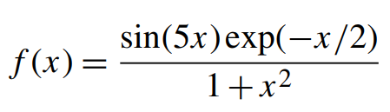
Exercise 1
Problem Statement
Write a script that displays a plot of the function
across the interval [−2, 3].
Add a title and label the axes for the graph.

Slide 13
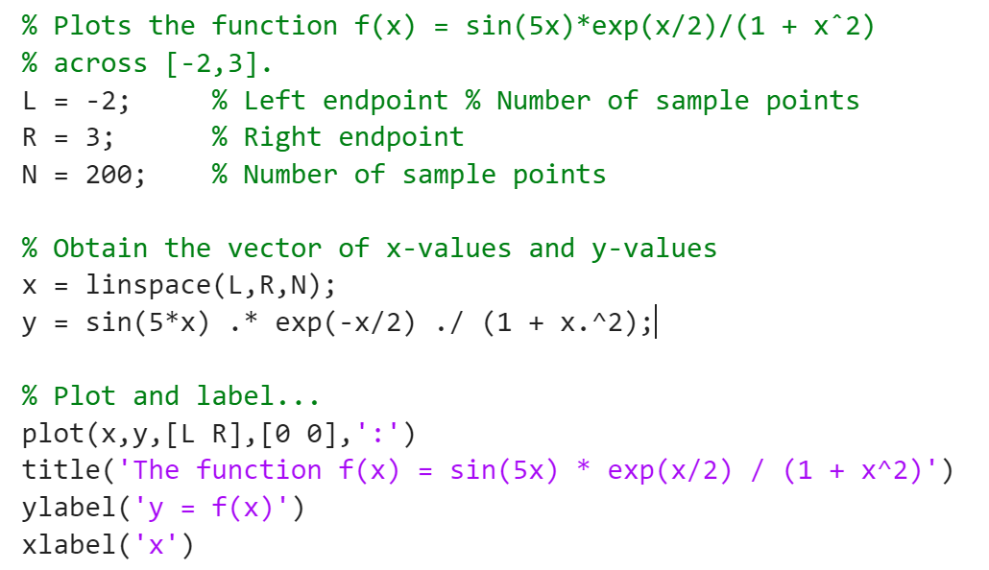
Code
This part of the plot function draws a dotted line connecting the points (L,0) and (R,0)

Slide 14
Exercises on arrays
MATLAB has a library of built-in functions for mathematical operations on arrays and matrices.
We are going to learn how some of these functions work and design our own.
It is good to understand the inner workings of these functions for our edification.

Slide 15
Exercise 2 : Sum and average
The built-in functions sum and mean can find the sum and average of all elements of an array.
Problem statement:
Write a MATLAB script to,
  Input an array from the user
  Find the sum of all the elements without using the built-in function
  Find the mean (average) of all the elements without using the built-in function
Use the sum and mean functions to verify your results.

Slide 16
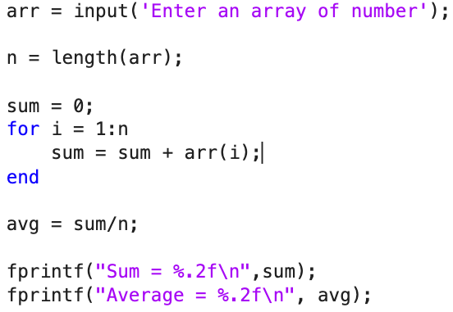
Code

Slide 17
Exercise 3: Cyclical rotation
Cyclically rotate an array by one element
Given an array, the task is to cyclically rotate the array clockwise by one time.
Examples:
Input: arr = [1, 2, 3, 4, 5]
Output: arr = [5, 1, 2, 3, 4]
Input: arr = [2, 3, 4, 5, 1]
Output: [1, 2, 3, 4, 5]

Slide 18
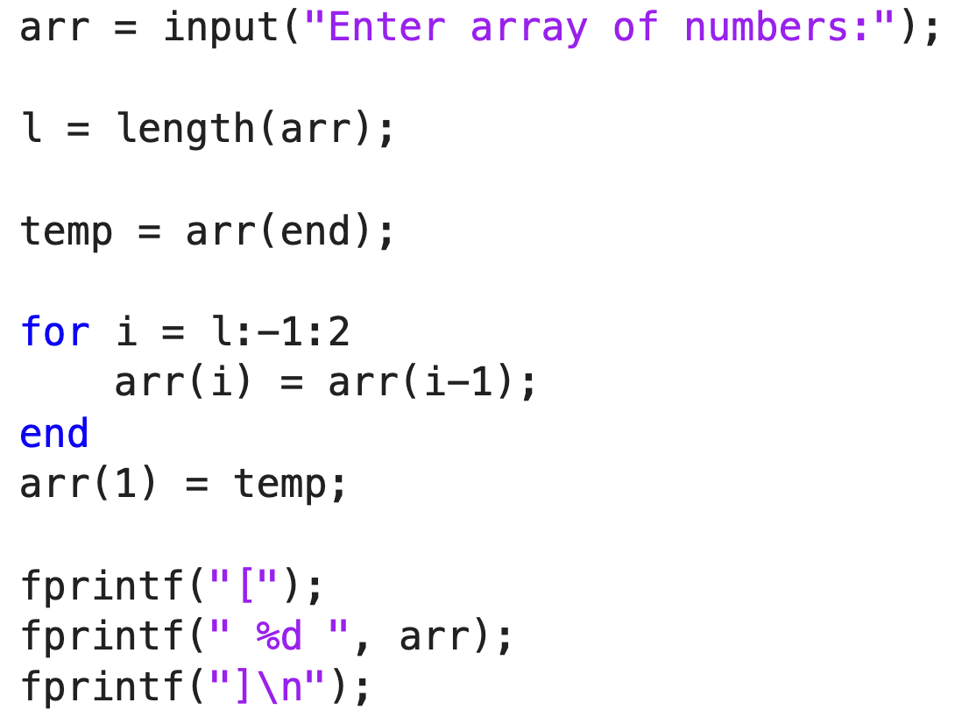
Code

Slide 19
Exercise 4: Find duplicates
Find duplicate elements in an array
Given an array of n integers. The task is to find all elements that have more than one occurrences. The output should only one occurrence of a number irrespective of number of occurrences in the input array.
Examples:
Input: [2, 10, 10, 100, 2, 10, 11, 2, 11, 2]
Output: [2, 10, 11]
Input: [5, 40, 1, 40, 100000, 1, 5, 1]
Output: [5, 40, 1]

Slide 20
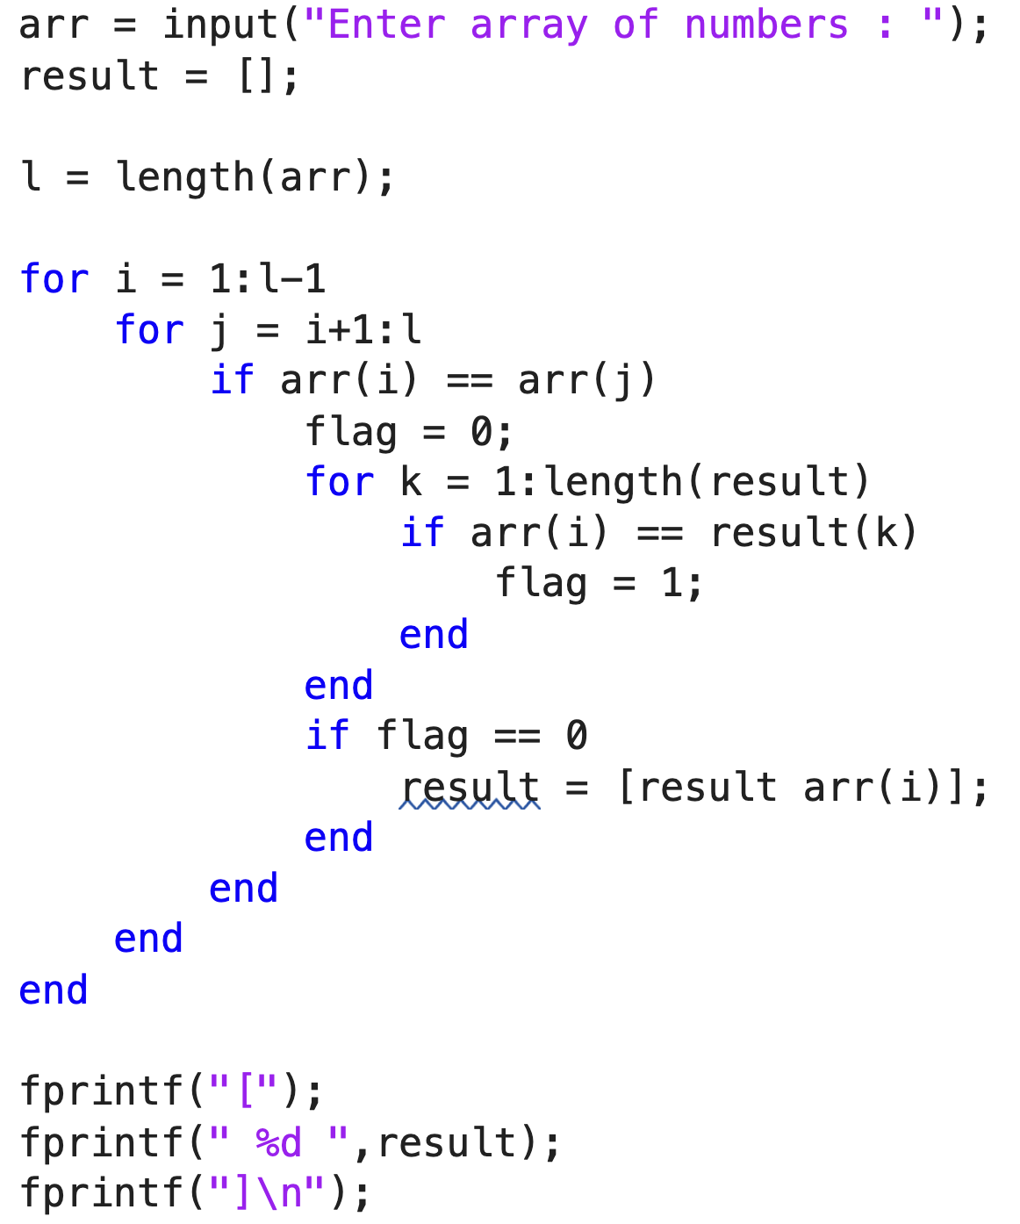
Code

